Slide 1
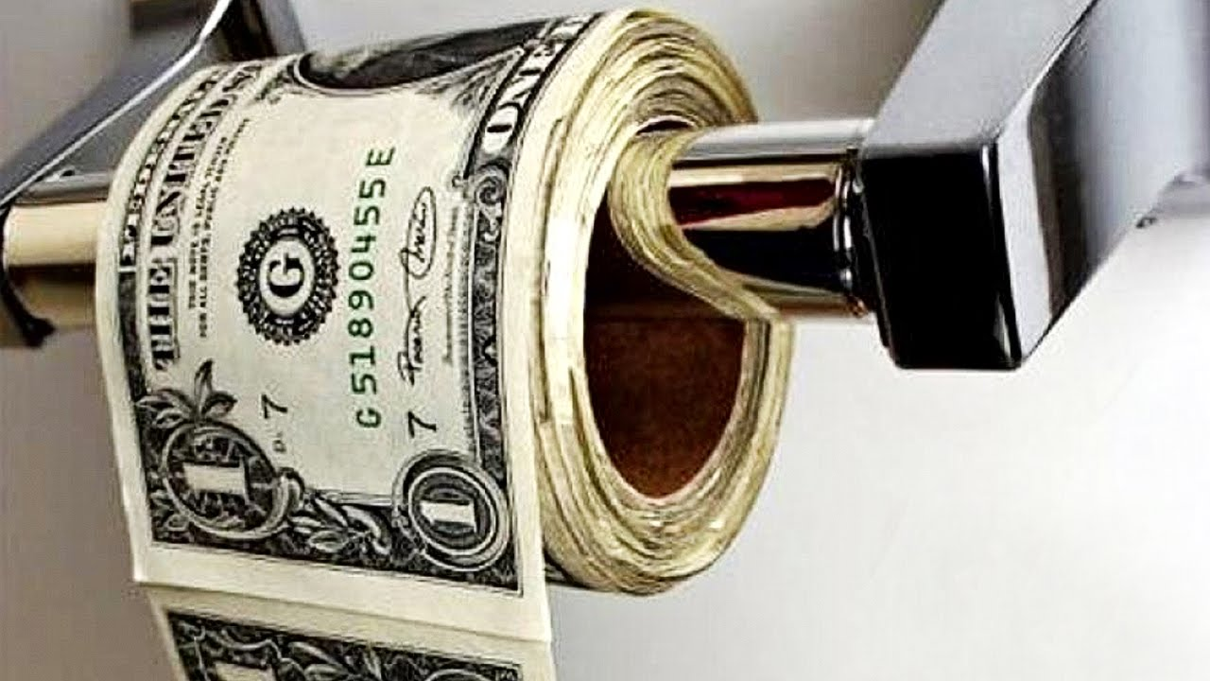
Chapter 17: Money & the Federal Reserve
Wayne Geerling
University of Texas

Slide 2
Big Questions
What is money?
How do banks create money?
How does the Federal Reserve implement monetary policy?

Slide 3
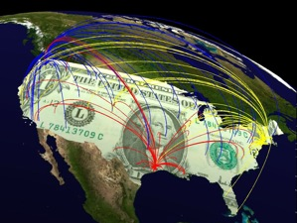
Did you know that...
Money is any medium that people generally accept in exchange for goods and services
wheresgeorge.com

Slide 4
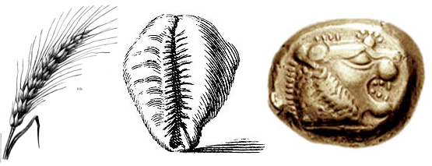
Types of Money throughout History
Iron Boar tusk Playing cards
Copper Red woodpecker scalps Leather
Brass Feathers Gold
Wine Glass Silver
Corn Wampum Knives
Salt Rum Pots
Horses Molasses Boats
Sheep Tobacco Pitch
Goats Agricultural implements Rice
Tortoise shells Round stones with centers removed Cows
Porpoise teeth Crystal salt bars Paper
Whale teeth Snail shells Cigarettes

Slide 5


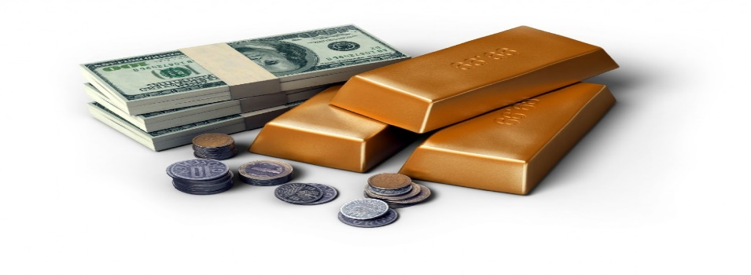
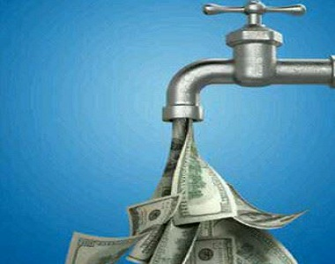
Functions of Money
Medium of exchange
Unit of account
Store of value
Liquidity*

Slide 6

What Backs the U.S. Dollar?
Is it:
(a) Gold
(b) Silver
(c) The Federal Government
(d) Faith & confidence

Slide 7
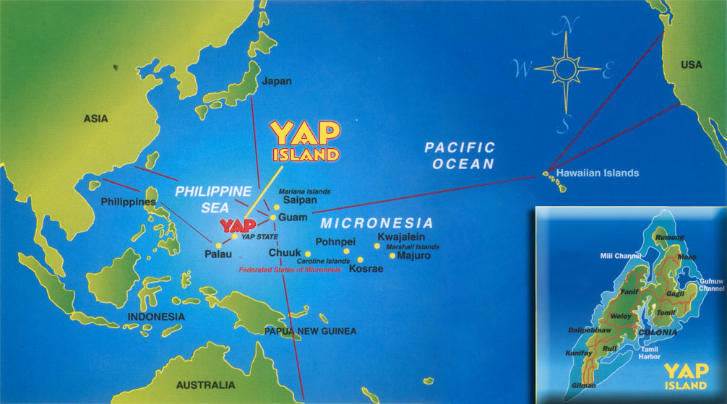

Slide 8
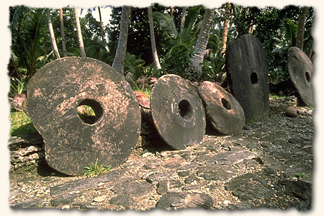
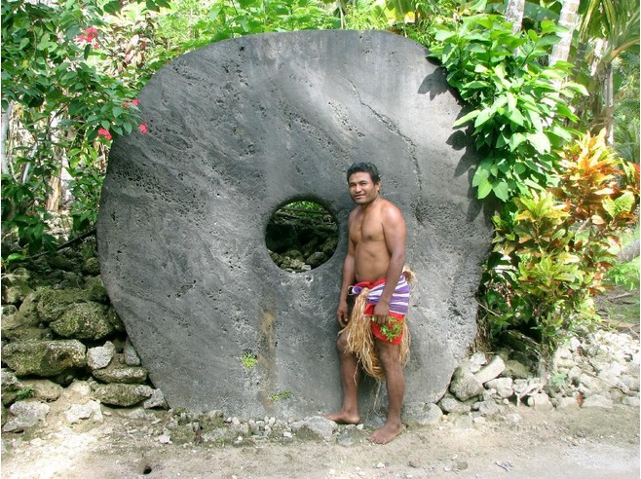

Show me the Fei

Slide 9
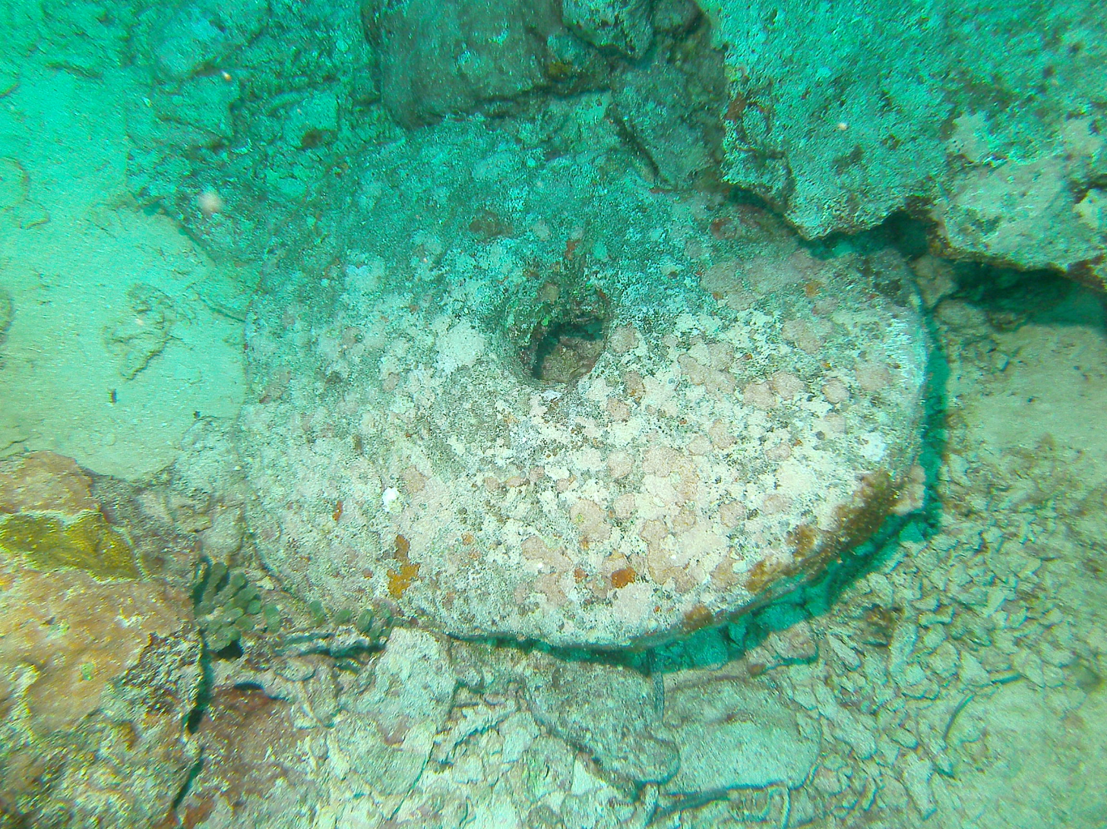
At one time, a stone was lost at the
bottom of the sea. However, the right to
that stone was traded for years to come.

Slide 10
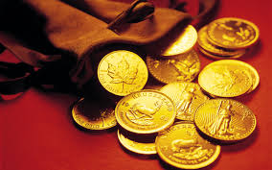
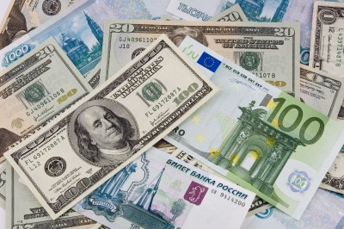
The Evolution of Money
=

Slide 11
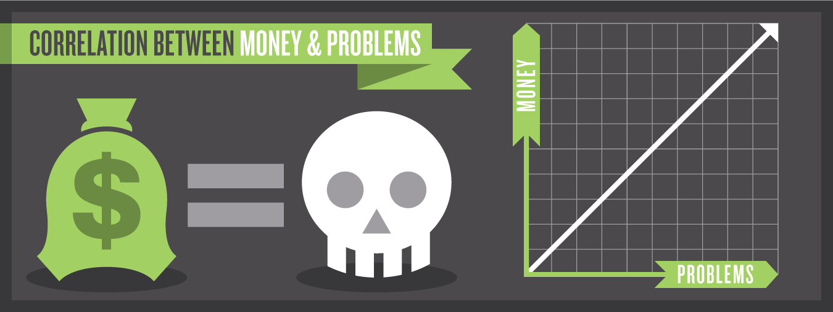
Problems with Fiat money
There are problems:
Unlimited printing/creation (Inflation)
Wears out (paper and coins)
Counterfeiting /used in underground economy

Slide 12
Measuring the Money Supply
Debit cards:
Access checking and/or savings accounts.
Credit cards:
Technically not a part of the money supply.
Involve a loan made at the cash register.
Bank deposits from elsewhere pay for the purchase.

Slide 13

The Crypto Bowl
1. Medium of exchange
2. Unit of account
3. Store of value

Slide 14
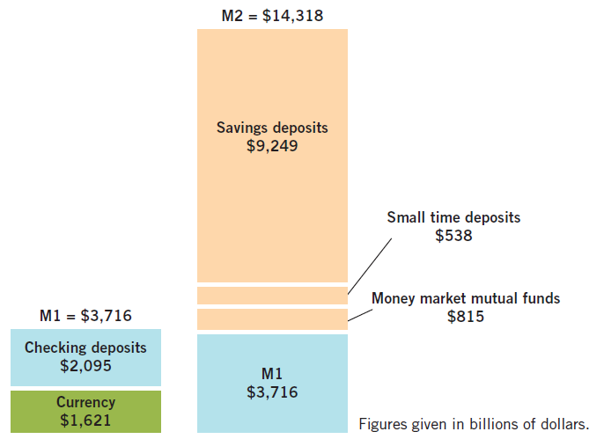
Measures of U.S. Money Supply: 2018*

Slide 15
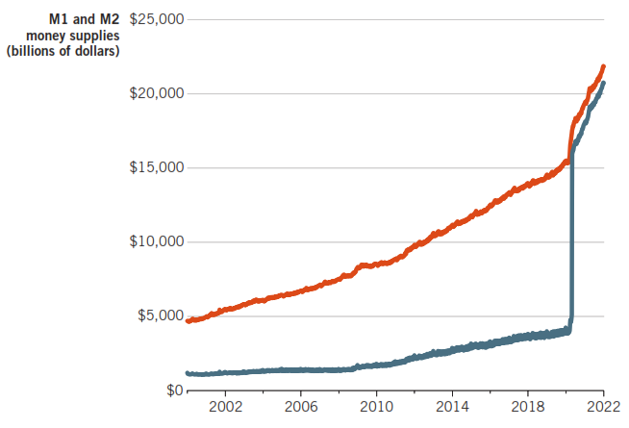
Measures of U.S. Money Supply, July 2020
As of 2020, savings deposits are also included in , so M1 + M2 are now almost

Slide 16
Business of Banking
Banks have two important roles in the economy:
They are critical participants in the loanable funds market.
Play a role in determining the money supply
Function is to serve as a financial intermediary.
Deposits: primary source of funds
Bank
Loans: primary use of funds
$$
$$

Slide 17
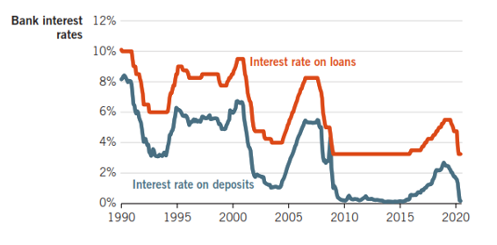
Interest Rates on Bank Deposits v Loans, 1990-2020
Banks charge more interest for loans than they pay for deposits. The difference pays the banks’ expenses & produces profits.

Slide 18
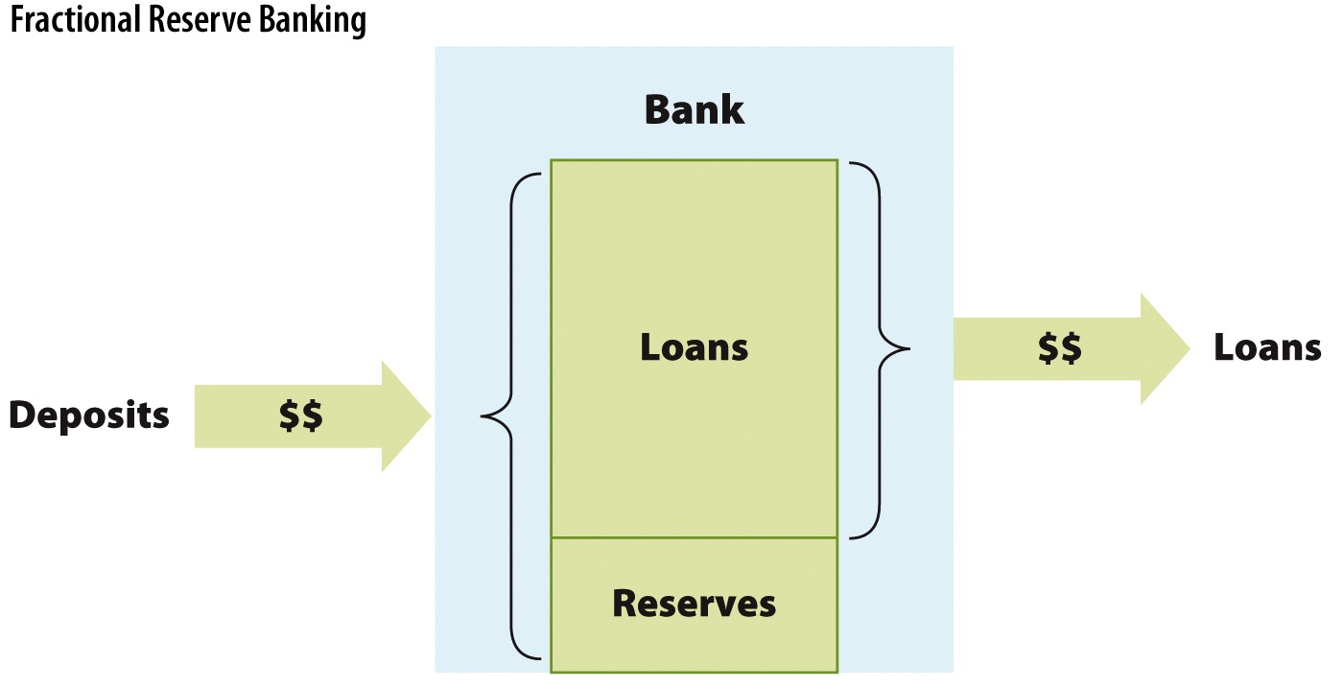
Fractional Reserve Banking
Figure 30.5 here

Slide 19
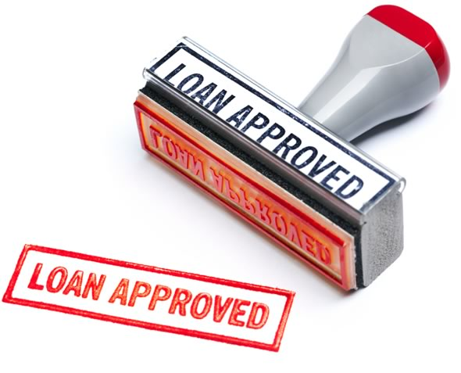
The Relationship Between Reserves and Total Deposits
What will a bank do with its excess reserves?

Slide 20
It’s a Wonderful Life
What would stop people from running to the bank?
Answer: deposit insurance

Slide 21
Moral Hazard and the FDIC
Between 1929-33, 9,000 banks failed.
In 1933, the U.S. government instituted federal deposit insurance through the Federal Deposit Insurance Corporation (FDIC):
Government program that insures your bank deposits.
Goal: increase bank stability, decrease bank runs.
Created moral hazard situation:
Moral hazard: lack of an incentive to guard against

Slide 22
Silicon Valley Bank Collapse

Slide 23
Which do you prefer?
Bank A:
Prudently invests your deposits in safe investments.
Returns a relatively low iel..
Bank B:
Takes considerable risks when it loans out deposits
Returns a relatively high yield
Deposits are insured by the FDIC

Slide 24
How Banks Create Money
Storyline:
Deposit $1,000
Bank loans out 90% ($900)
Can withdraw initial $1,000 deposit
Someone else has a $900 loan
New money!

Slide 25
Example of Banks Creating Money
Two simplifying (but unrealistic) assumptions:
All currency is deposited in a bank
Banks hold excess reserves (rr = .10)
Example:
Alexis gets a $900 loan to pay for college tuition
The college deposits this money in its bank
This bank then lends out the money
Let’s examine the balance sheets of each bank.

Slide 26
Money Creation Example
University Bank (the bank from which Alexis borrowed the $900)
Assets |  | Liabilities and Net Worth
Reserves | +$100 | Deposits | +$1,000
Loans | +$900
Township Bank (the bank the college uses)
Assets |  | Liabilities and Net Worth
Reserves | +$90 | Deposits | +$900
Loans | +$810

Slide 27
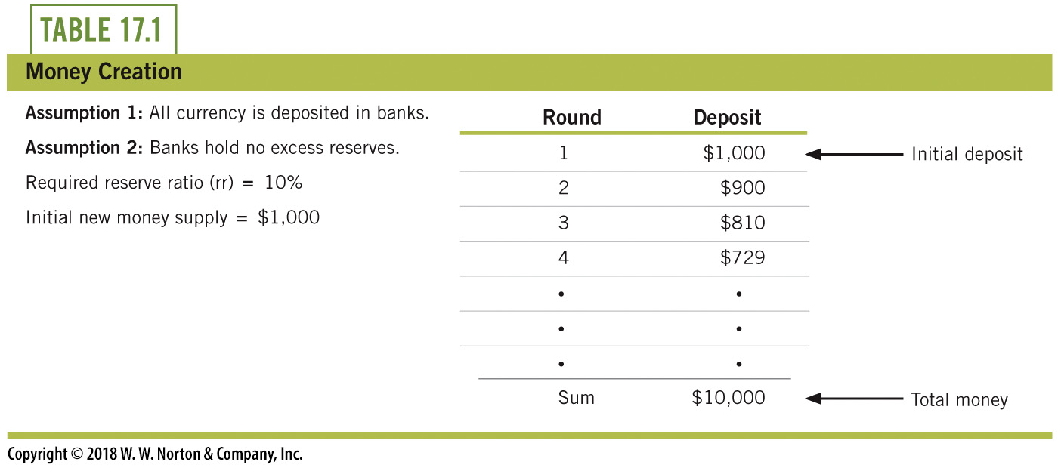
Example of Banks Creating Money

Slide 28
The Money Multiplier
With a reserve requirement of 5% & an initial deposit of $400, what is the total amount of money that could be in the money supply?
1
Simple Money Multiplier =
Required Reserve Ratio
Answer: The money multiplier is 1/.05 = 20
Maximum impact on MS (total money): $400 * 20 = $8,000

Slide 29
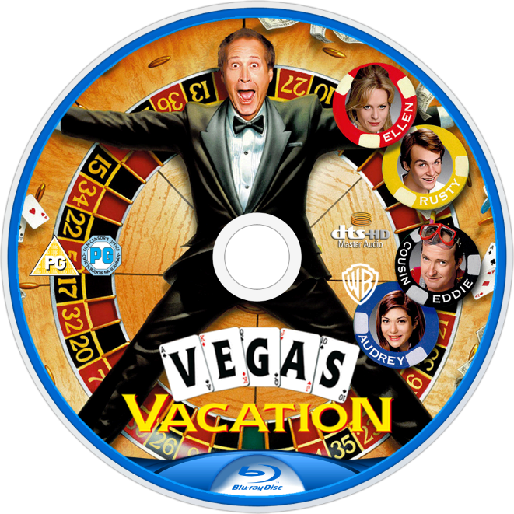
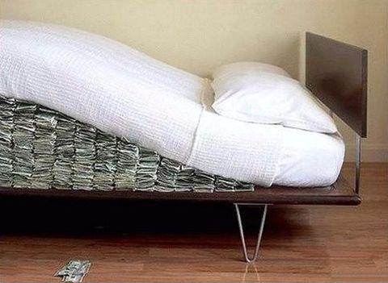
Leakages
Currency drains
Excess reserves

Slide 30

The Federal Reserve
The Federal Reserve (Fed): central bank of United States
Three responsibilities:
Monetary policy
Central banking
Bank regulation
Current chairman of the Fed
Jerome Powell

Slide 31
Roles of the Federal Reserve
The Fed acts as a “bank for banks.”
It holds federal funds which are deposits that private banks hold on reserve at the Federal Reserve.
Banks keep reserves at the Fed because the Fed clears federal funds loans, loans between banks.
The interest rate on loans between private banks is called the federal funds rate.

Slide 32
Roles of the Federal Reserve
The Fed also acts as a lender of last resort.
Discount loans: Loans from Fed to private banks
Discount rate: The interest rate on the discount loans made from Fed to private banks.
The Fed also serves as a regulator of individual banks.
Responsibilities include setting and monitoring reserve requirements.

Slide 33
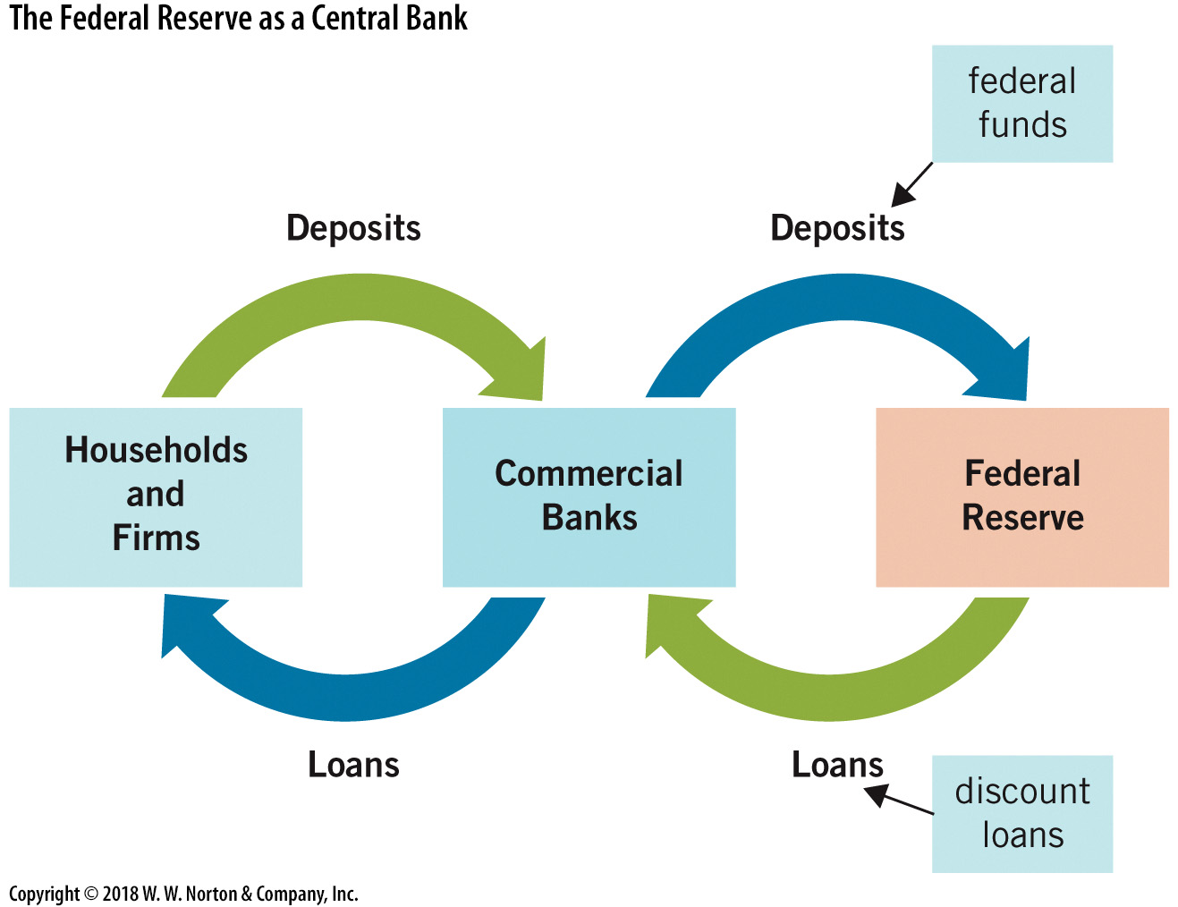
Federal Reserve: A Bank for Banks

Slide 34
Monetary Policy Tools
The Fed has several tools it can use to alter the money supply:
1. Interest on reserves
2. Open market operations
Includes quantitative easing
3. The discount window
Includes special lending facilities

Slide 35
1. Interest on Bank Reserves
The Federal Reserve pays interest on reserves on deposit with it.
This practice started in 2008.
By adjusting the rate of interest on reserve balances (IORB), the Fed makes it more or less attractive for banks to maintain reserves.
This influences the reserve ratio banks maintain.
Higher IORB → higher rr. Lower IORB → lower rr.
By manipulating rr, the Fed manipulates mm and thereby the

Slide 36
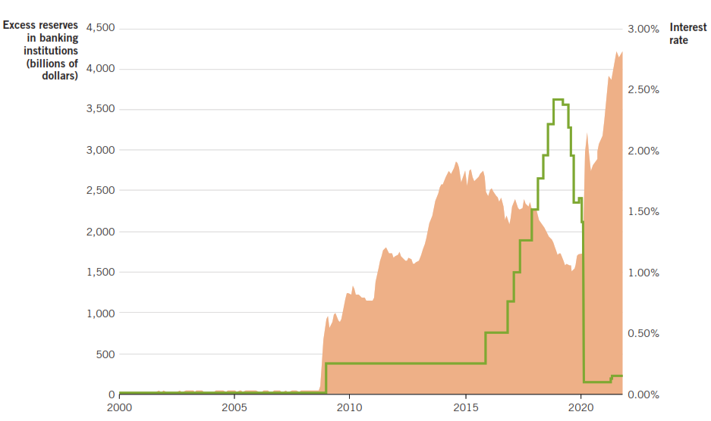
Bank Reserves & the IR Paid on Reserves
It is no coincidence that the excess reserves climbed immediately after the Fed began paying interest on reserves.

Slide 37
2. Open Market Operations
The purchase or sale of bonds by a central bank:
Buys securities → increase the money supply
Sells securities → decrease the money supply
When performing OMO, the Fed typically buys & sells short-term Treasury bonds for two reasons:
1. The Fed’s goal is to get the funds directly into the market for loanable funds.
2. The market for Treasury bonds is big enough so that the Fed can buy & sell without difficulty.

Slide 38
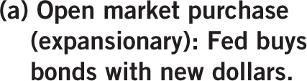
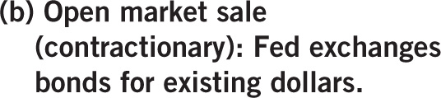

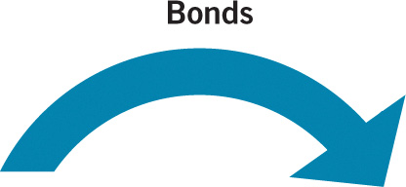
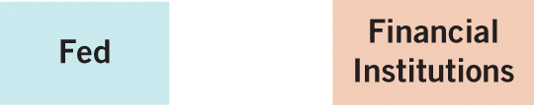
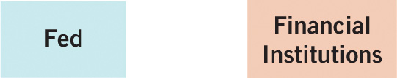


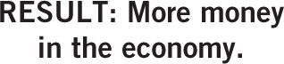
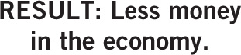
Open Market Operations

Slide 39
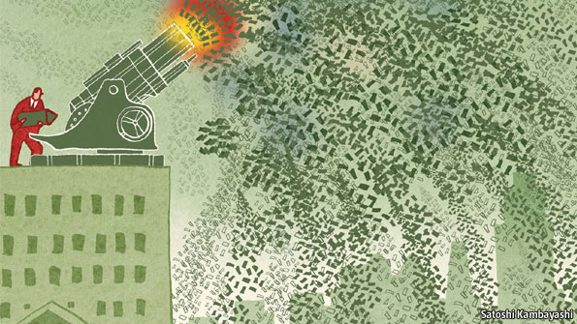
When All Else Fails: Quantitative Easing
End of 2008, worst quarter in U.S. in 50 years
Real GDP down 8.9%, unemployment up

Slide 40
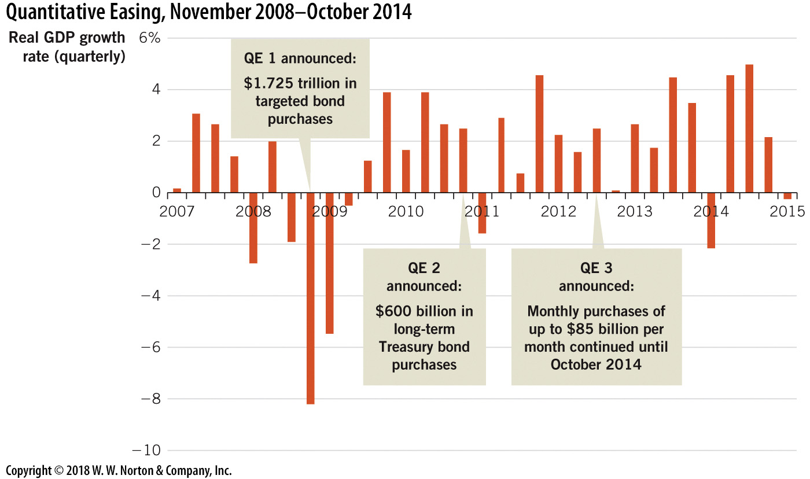
Quantitative Easing, 2007–2014

Slide 41
3. Discount Window and New Lending Facilities
Discount window: Struggling entities can borrow money directly from the Federal Reserve.
Historically, the discount window was for banks.
Since the Great Recession, special lending facilities have provided loans to other firms in difficulty.
Private firms in the financial industry
State and local governments
Small businesses, hospitals, and nonprofits

